Slide 1
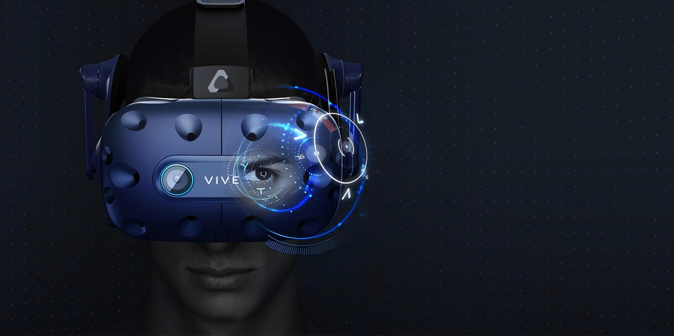


Simulating Human Eye-Gaze in Virtual Reality
Chaz Lambrechtsen| 45426317 | Software Engineering
Supervisors: Dr Malcolm Ryan & Dr Mitchell McEwan
Notes:
Hi everyone my name is Chaz and I will be presenting my research on eye-gaze patterns and simulation

Slide 2
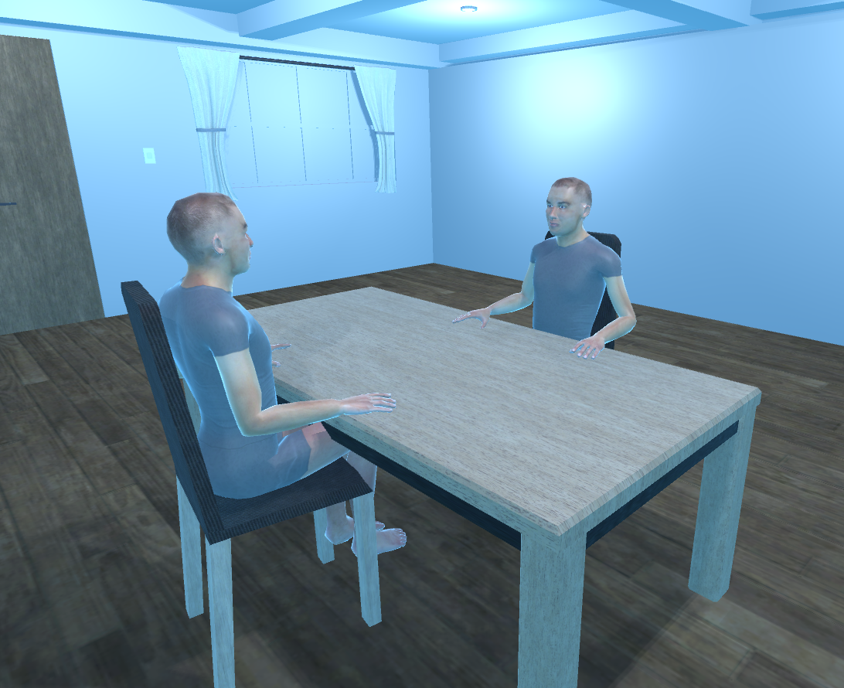
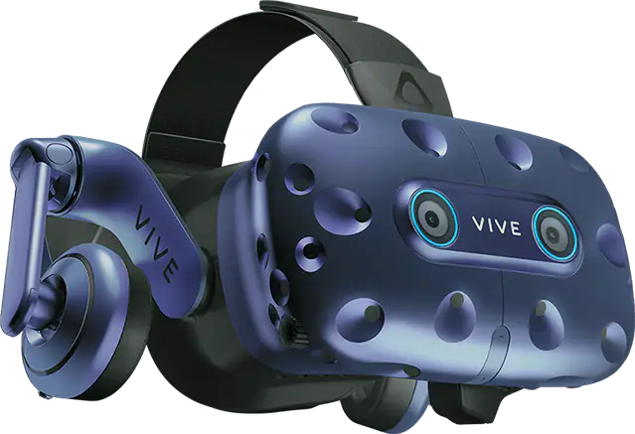
Introduction
Eye-Gaze VR Simulation
Vive Eye Pro
Notes:
The latest Vive VR headset includes eye-tracking, which allows us to monitor a person’s eye gaze in real time. In this project we are interested in using this feature to track the eye gaze of people. The aim is to build a Unity simulation which networks two people in virtual reality taking part in a simple game. The simulation will monitor a person’s head and eye positions then display it on their avatar for the other person to see. The eye gaze of these two people will be monitored and analysed for patterns and used to simulate an agent avatar capable of playing the game and displaying different types of eye gaze.

Slide 3

Research Questions
INTRODUCTION
Research question 1 What kind of eye gaze patterns and behaviors are shown during avatar-based human-to-human interaction in VR?
Research question 2 What effect does social eye-gaze have in virtual reality, does it make players feel a sense of connection?
Research question 3 Can the patterns and behaviors found in research question 1 be simulated with an agent in VR?
Notes:
These are the research questions that I will be looking to answer in this research:
The questions aim to capture the overall goals of the research and experiments

Slide 4
Background Research Areas
INTRODUCTION
Human Eye-Gaze Patterns
Eye-Gaze During Conversation
Eye-Gaze Patterns During Gameplay
Virtual Eye-Tracking and Gaze Simulation
Eye Tracking Technical Details
Virtual Avatar Eye Gaze and Patterns Simulation
Interaction Fidelity and Attention Bias in VR
Avatar Animation
Head Animation Based on Eye Gaze
Inverse Kinematics
Notes:
And this is an overview of the research topics I have covered in my thesis throughout this semester. I will not cover all of these topics as there is not enough time, however I will cover most relevant for this research.

Slide 5
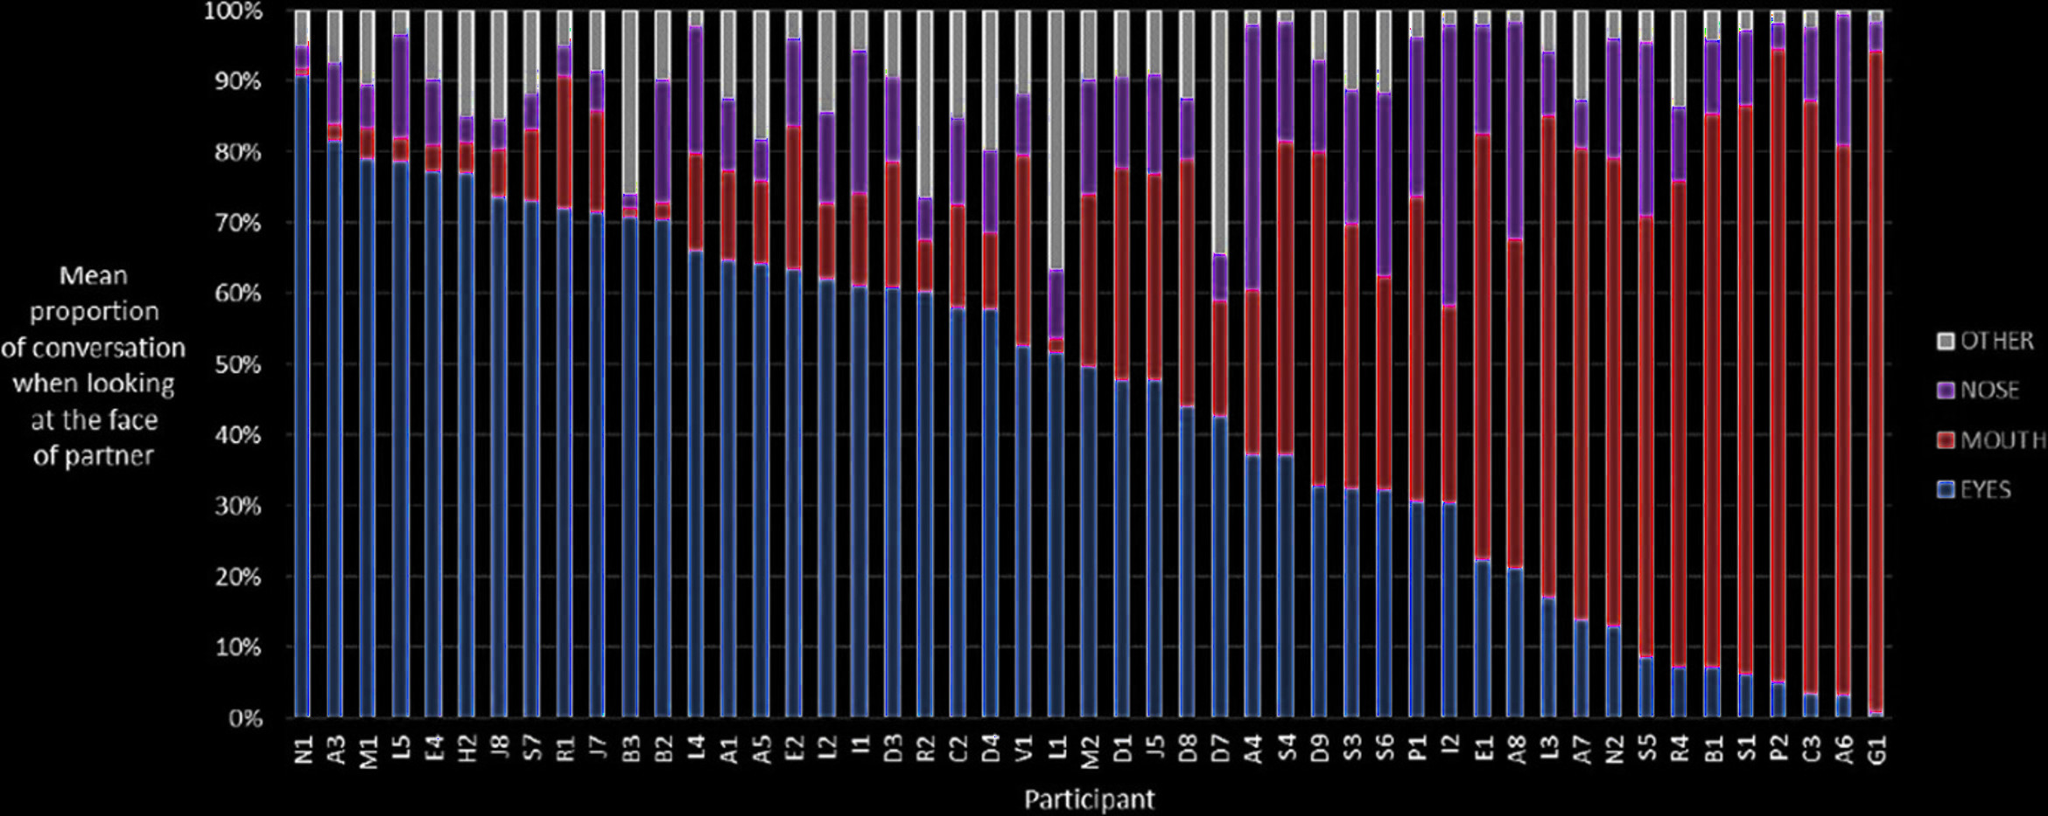
Eye-Gaze During Conversation
HUMAN EYE-GAZE PATTERNS
Figure 1 - Differences in gazing behavior on the face during conversation [1].
Notes:
There is research that has shown that dual eye tracking can be used to uncover personal gaze patterns during social interaction. Analysis of eye-gaze patterns revealed that during a social interaction different people tend to look at areas of the face when they are paying attention to another person these areas include the eyes, mouth, and nose. When interacting with an artificial agent there are similar results.
The ‘other’ category is the forehead and looking away from the face.

Slide 6
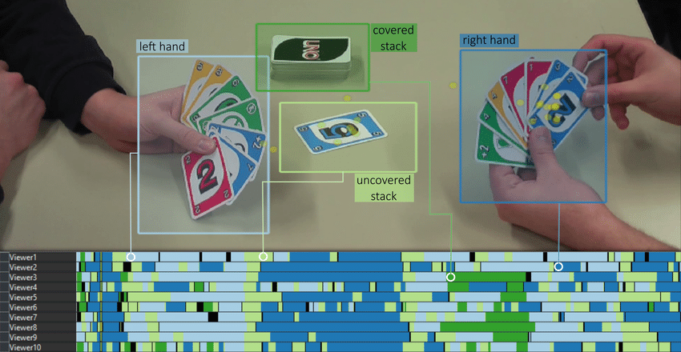
Eye-Gaze During Gameplay
HUMAN EYE-GAZE PATTERNS
Figure 2 - Scarf plots of individual participants following the UNO game. [2]
Notes:
Some research has shown that utilizing eye gaze during gameplay can heighten social and or strategic elements of a game, such as the player’s gaze giving away their intentions in multiplayer situations.
When playing a game, specifically card games and board games, people tend to reveal their next moves just by their eye-gaze, even if it is just a slight glance. If you look at the bottom of this figure, you can see when participants anticipated a player drawing a new card from the covered stack.

Slide 7
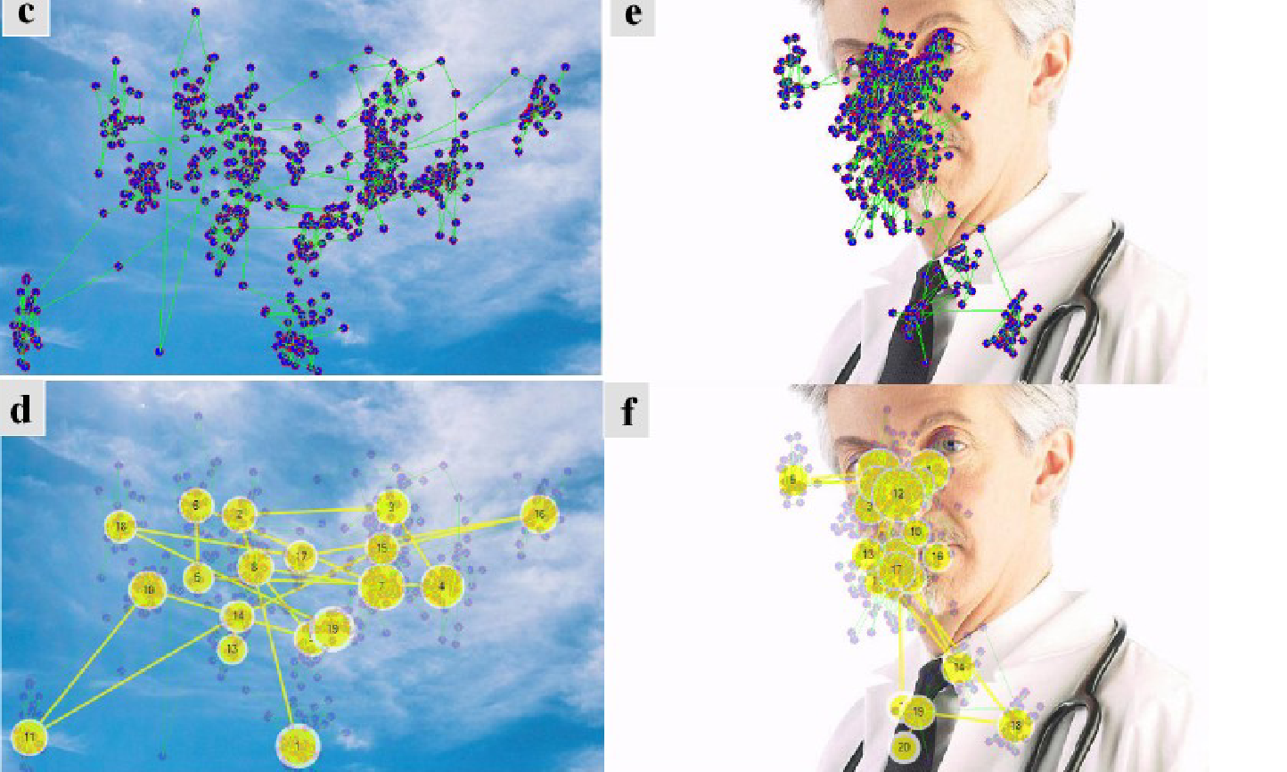
Virtual Avatar Eye Gaze and Patterns Simulation
VIRTUAL EYE-TRACKING AND GAZE SIMULATION
Figure 3 – Generating eye gaze data showing RoI [3]
Notes:
This research was also very interesting and shows an AI model based on a Time Delay Neural Network is used for simulating eye gaze data has been used to generate regions of interest. This model has also been trained with human Eye-Gaze.
And according to this study, the neural network also recognised the eyes, nose, and mouth as Regions of Interest

Slide 8
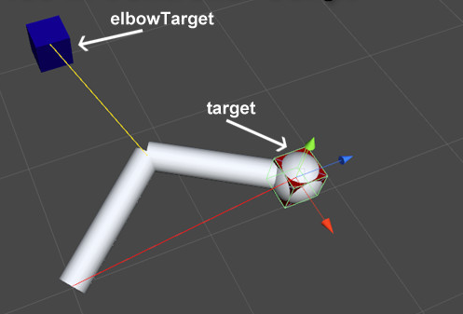
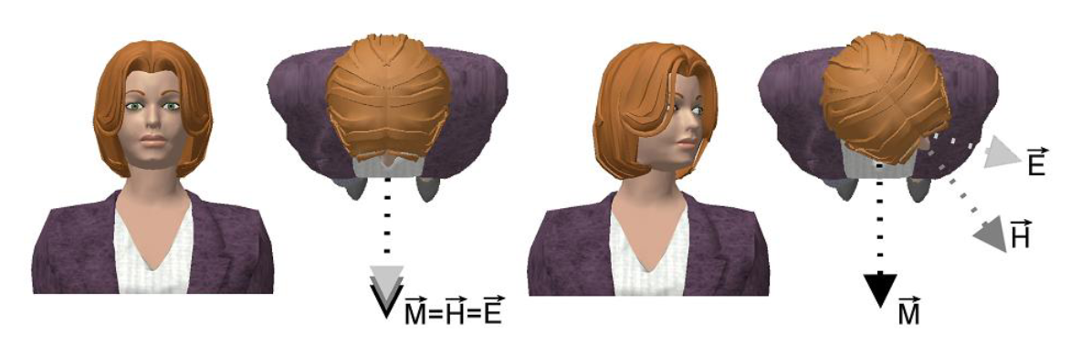
Head, Eye and Arm Animations
AVATAR ANIMATION
Figure 4 – FABRIK Inverse Kinematics in Unity [4]
Figure 5 - Head animation based on eye gaze [5]
Notes:
I also needed to learn and discover how the head, eyes and arms can be animated. For this I found a relevant inverse kinematics algorithm and a research paper that explains eye-gaze based head animations.
On the left is the FABRIK algorithm which is mostly used for human limb animations as it is efficient with less joint iterations.
On the right is a diagram showing a simulation of oculomotor range which is the range that your eyes can see until your head is required to move

Slide 9
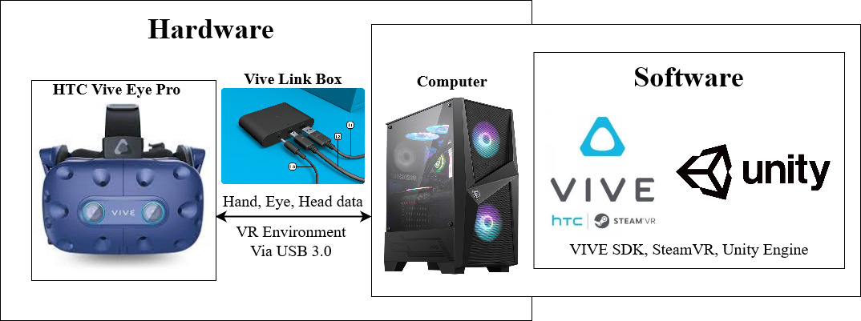
Technical Setup Overview
REQUIREMENTS
Notes:
This is the technical setup for the experiment, so for each player, the HTC VIVE headset will be connected to a Vive Link which is connected to a computer. The computer will be running the unity simulation and using other software such as the VIVE SDK to make this happen. The unity simulation will also be networked to one other player so the players can be in the same virtual room.

Slide 10
Experiment 1&2 (Physical)
METHODOLOGY
Person 1
Table
Room 1
= VR Headset
= Physical Objects
= Physical Person
Table
Person 2
Room 2
Notes:
So now I would like to show you our methodology for the experiments.
In the real world, players will be in separate rooms, the reason for this is because when a person plays against an agent and not a person then they will have the same setup, each room will include a similar setup, with a table and VR headset.
Players will not be allowed to talk during the experiment.

Slide 11
Experiment 1 (Virtual)
METHODOLOGY
Table
Virtual Room
= Virtual Avatar
Avatar 1
Avatar 2
Research question 1 What kind of eye gaze patterns and behaviors are shown during avatar-based human-to-human interaction in VR?
= Virtual Objects
BoardGame
= Virtual Eye
= Virtual Eye-Gaze
Notes:
In the first experiment, the virtual environment will connect the two players in a single virtual room, each person represented by avatars in the game. This experiment is related to research questions 1 and 2

Slide 12
Experiment 1 A/B Test (Virtual)
METHODOLOGY
Table
Virtual Room
Research question 2 What effect does social eye-gaze have in virtual reality, does it make players feel connection
= Virtual Avatar
Inanimate
Avatar 1
Inanimate
Avatar 2
BoardGame
= Virtual Objects
= Virtual Eye
Notes:
To confirm that players feel a connection and pay attention to each other, we will run another experiment with the same stimulus except avatars head and eyes will not be animated.
This confirms research question 2.

Slide 13
Experiment 2 (Virtual)
METHODOLOGY
Person 1
Table
Agent Avatar 1
BoardGame
Virtual Room 1
= Agent Avatar
= Virtual Avatar
Research question 3 Can the patterns and behaviors found in research question 1 be simulated with an agent in VR?
= Virtual Objects
= Virtual Eye
Person 2
Table
Agent Avatar 2
= Virtual Eye-Gaze
BoardGame
Virtual Room 2
Notes:
Finally, in the second experiment each human player will be against an artificial agent in virtual reality with simulated animations. Players will not be aware that they are not versing an agent, the experiment will be setup in such a way that players will be convinced that they are versing a human.

Slide 14
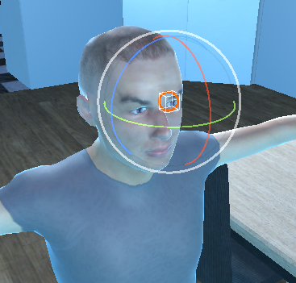

Measuring and Analysing
METHODOLOGY
Pre-test
Data collection
Post-test
Analysis
Notes:
Before these 2 experiments we will run a pre-test survey which will measure basic demographic information and game experience.
During the experiments we will collect eye-gaze data from the headset at 10 samples per second and record which object is being looked at. The simulation will be recorded from a virtual camera with eye beams to show eye-gaze directions.
The post-test survey after each experiment which will measure in-game satisfaction of psychological needs with a 7-point Likert scale from ‘strongly disagree’ to ‘strongly agree’ .
Finally, data that we have collected will be visualised to search for patterns and conduct basic statistical analysis including the T-Test, to compare differences between means.

Slide 15
Conclusion
Similar eye-gaze as previous research.
Players feel a sense of connection.
Eye-gaze patterns can be simulated?
Notes:
In conclusion we are expecting similar human-to-human eye-gaze patterns as we have seen in previous research papers and these head and eye-gaze animations would make players feel a sense of connection.
Finally, we will find if these eye-gaze patterns can be simulated on a virtual artificial agent and if a player can be convinced that the agent is a human.

Slide 16
References
[1] S. L. Rogers, C. P. Speelman, O. Guidetti, and M. Longmuir, “Using dual eye tracking to uncover personal gaze patterns during social interaction,” Nature News, 09-Mar-2018. [Online]. Available: https://www.nature.com/articles/s41598-018-22726-7. [Accessed: 05-Aug-2021].
[2] M. Burch, “Visual analysis of eye movements during game play,” Research Gate. [Online]. Available: https://www.researchgate.net/publication/340535842_Visual_Analysis_of_Eye_Movements_During_G ame_Play. [Accessed: 16-Oct-2021].
[3] P. Taylor, V. Francis “A time delay neural network model for simulating eye gaze data,” Taylor & Francis. Available: https://www.tandfonline.com/doi/abs/10.1080/0952813X.2010.506298. [Accessed: 30-Sep-2021].

